Slide 1

SWS3009A
Robotics and Deep Learning
Deep Learning Trial Lecture
colintan@nus.edu.sg

Slide 2

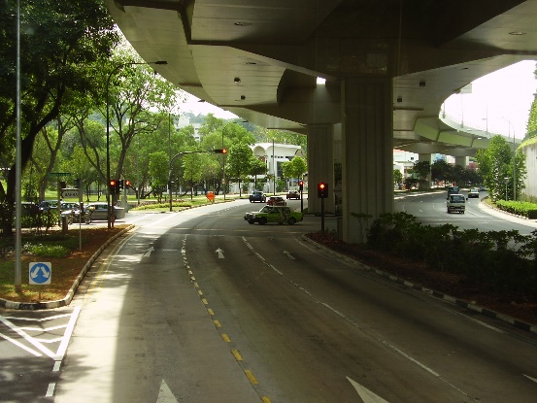

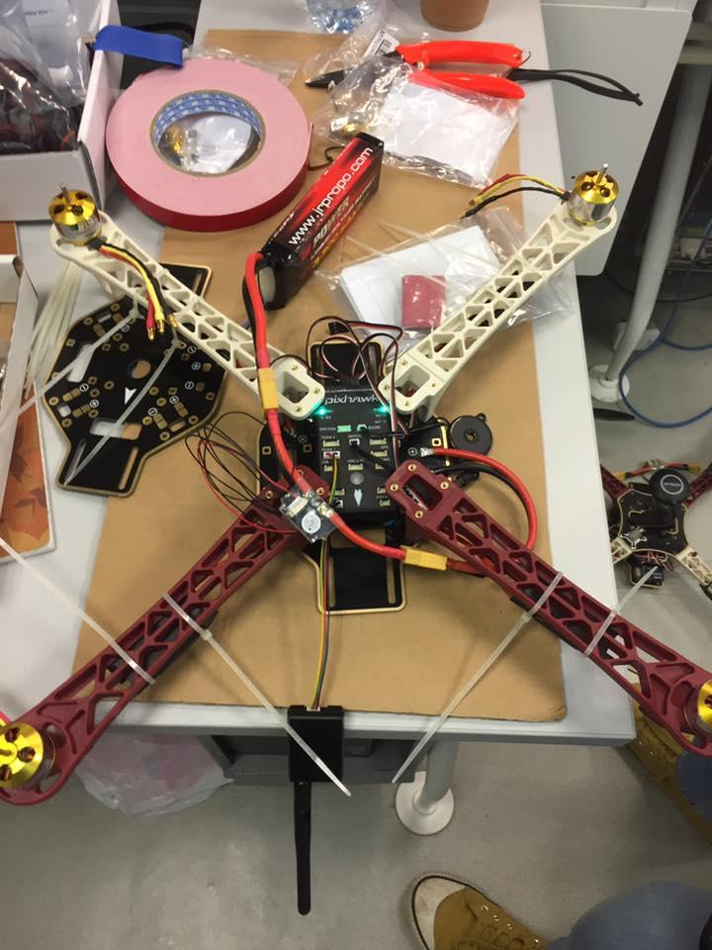
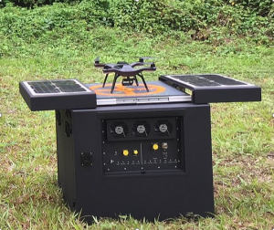
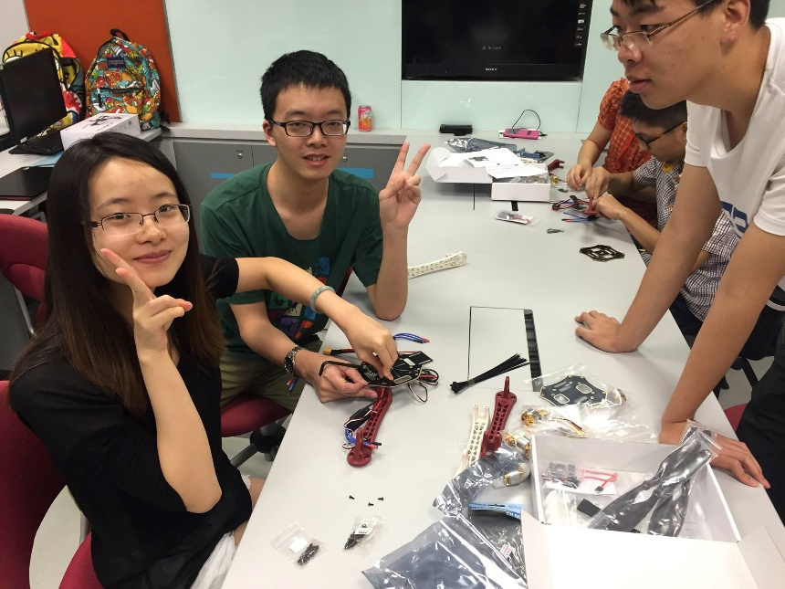
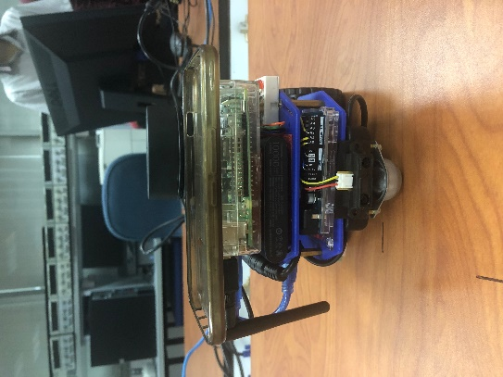


About Me
Colin Tan
Department of Computer Science, NUS School of Computing.
Email:
colintan@nus.edu.sg

Slide 3

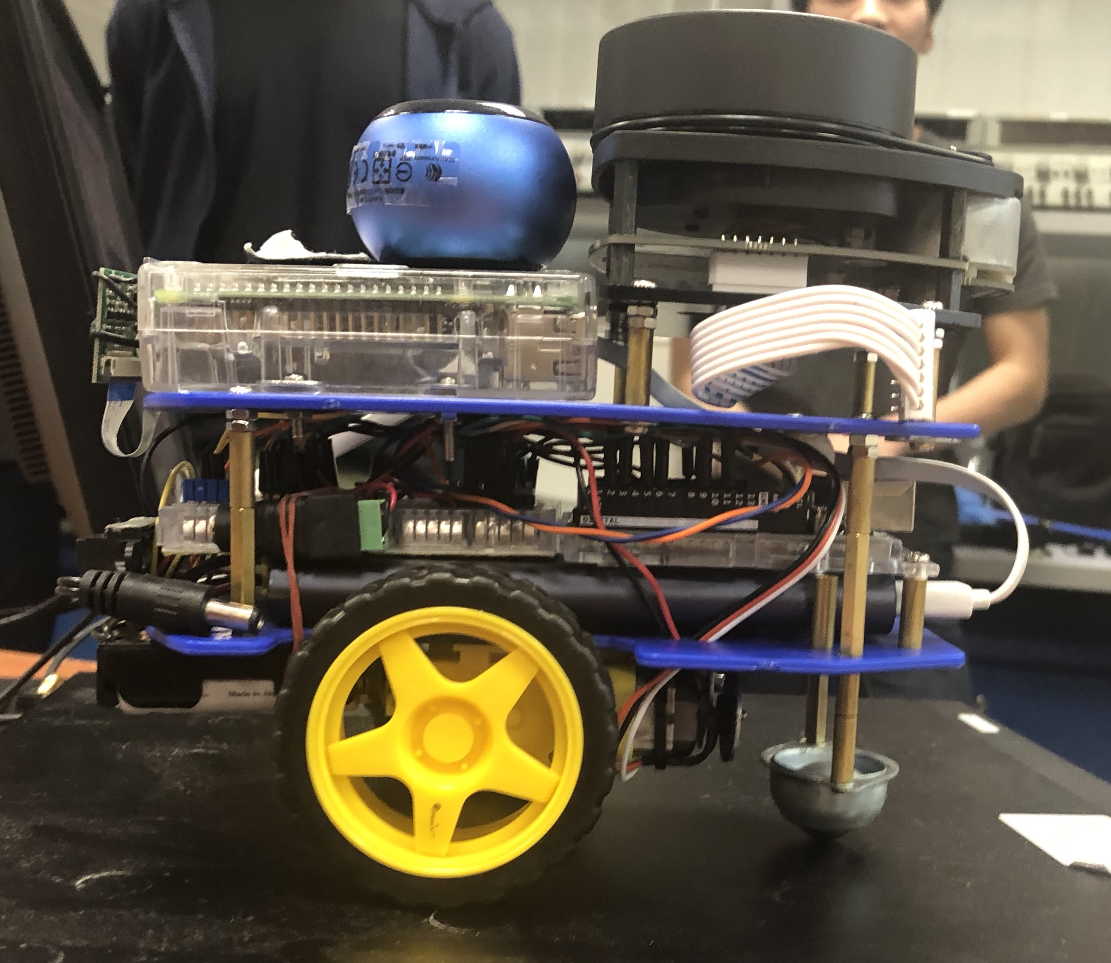
Our Motivation
ChatGPT is (sort of) awesome!
GPT4 has digested almost all the text in the universe! (I.e. what’s available on the internet)
But it’s just text; life is more than text!
Our goal then is to integrate AI with sensors and actuators.
What could be more fun than working with robots?
Our methodology:
Two tracks – One on robotics and one on AI.
Two projects:
A baseline project to ensure you’ve gotten all the basic concepts down.
A project that YOU dream up.

Slide 4
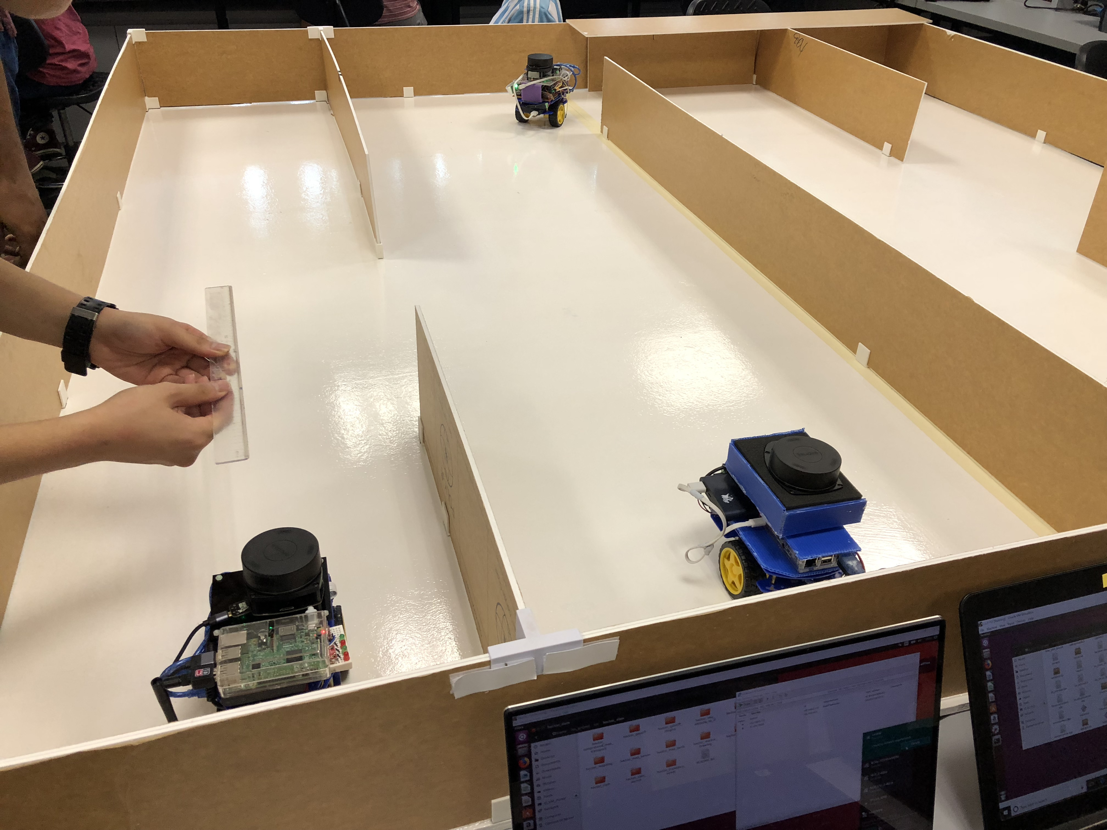
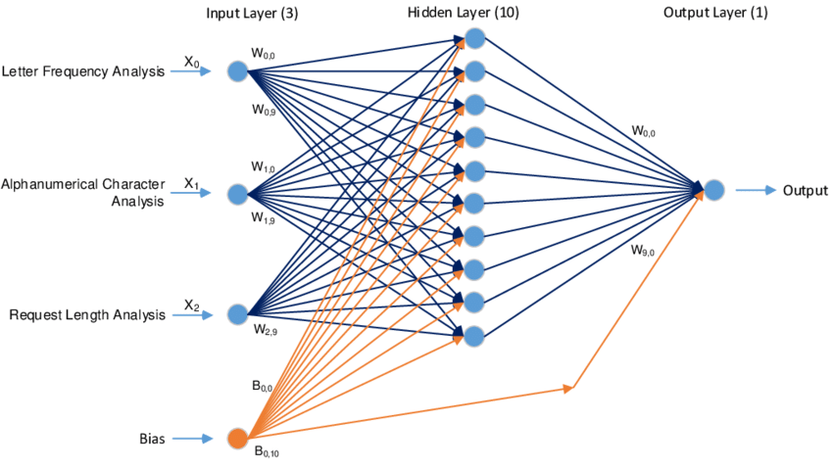
What You Will Learn (Quick Summary):
Boyd’s Part: Robotics
The hardware aspects of building a robot
Connecting and programming robot sensors.
Controlling the robot remotely
Hardware security.
My Part: The “brain” of the robot
Machine learning:
Statistical Methods.
Neural Networks.
Deep Learning Networks.
Communications.
Reverse tunnels:
Control your robot from any part of the world
Transport layer security

Slide 5
Course Structure
Trial Lecture Only: You will be attending both my part and Boyd’s part.
Decide whether you want to do hardware or deep learning.
You will be doing this topic throughout the workshop.
You are STRONGLY encouraged to take the topic you are not familiar with:
Take hardware if you’re a deep learning person.
Take deep learning if you’re a hardware person.
If you are neither, take the part that excites you most.
This way you can maximize what you get from this Summer Workshop.

Slide 6
Course Structure
Structure:
You will be organized into teams:
Hopefully 2 hardware, 2 deep learning per team.
Hardware and deep learning groups will have separate lectures.
In Phase 2 you will attend only ONE track of lectures, not both.
You will be working together (hardware + deep learning) on a baseline project.
Build a robot to explore a maze and find targets.
After the baseline project, you will work on your own project.
We will be looking at several very interesting deep learning models:
Convolutional networks to recognize objects.
Generative networks to produce new data from old.
Object detection networks to track objects.
LSTM and Transformers for understanding time-series data.
Auto-encoders to detect problems.

Slide 7
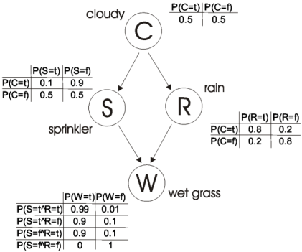
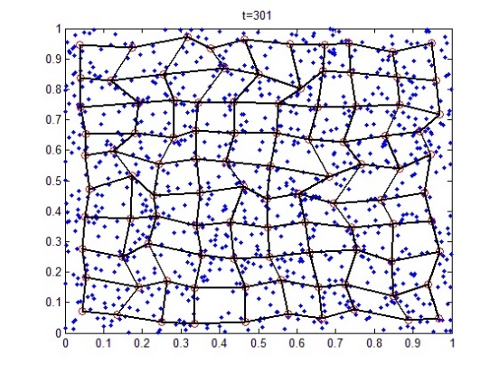
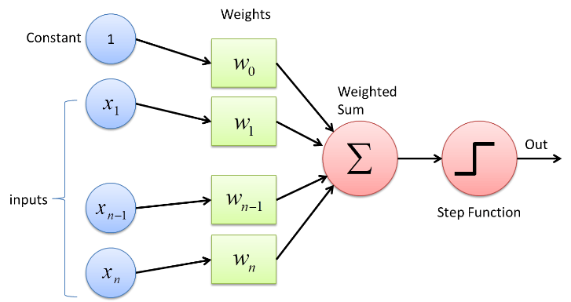
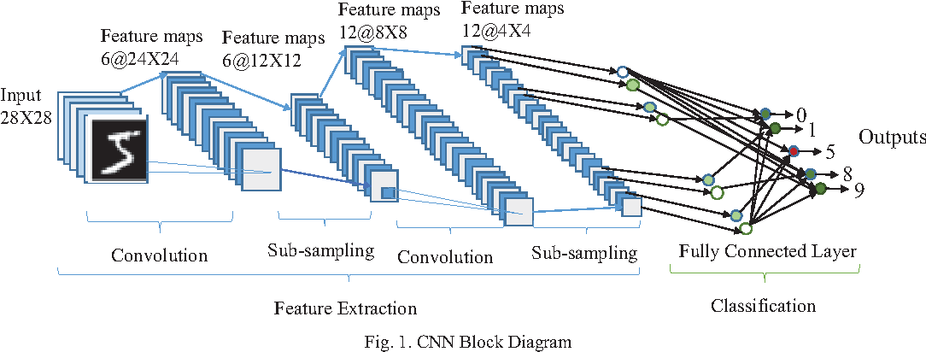
What Is Machine Learning?
In machine learning:
We present the machine with A LOT of data.
Machine learns on its own to recognize patterns in the data.

Slide 8
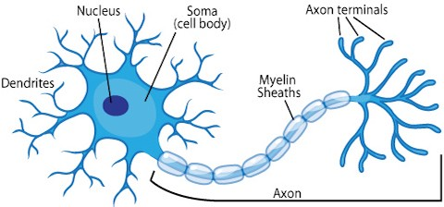
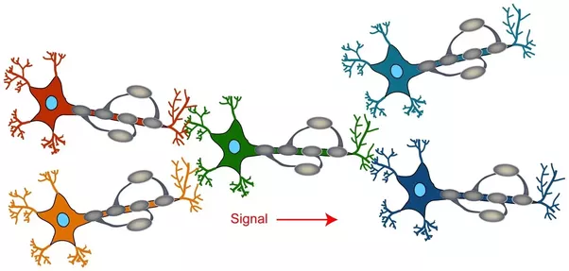
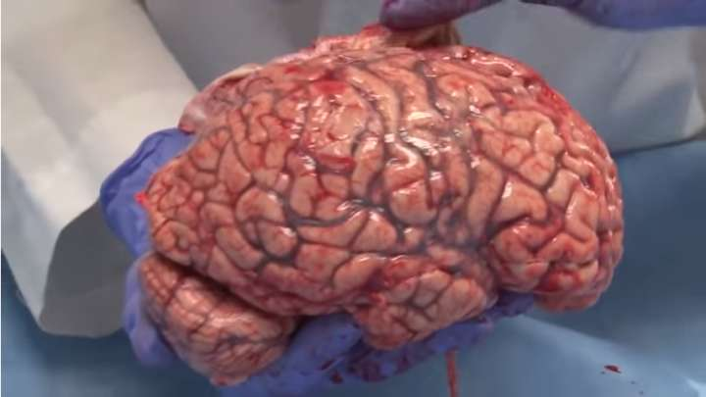
Neural Networks: Biological Inspiration
Neural networks are inspired by biological neurons: Units of computation that are in our brain and nervous system:
Each neuron takes electrical signals from surrounding neurons.
Signals pass through gaps called “synapses” that pass a portion of the signal through.
“Strong” synapses pass more signals, “weak” synapses pass weaker signals.
The neuron sums these signals and fire if they exceed a “threshold”.
To lean, the synapses are strengthened or weakened.

Slide 9
Deep Learning
Primary limitation of neural networks:
Neural networks learn by adjusting “parameters” according to a “learning law” (We will cover learning laws later), based on the data presented.
Need large number of “parameters” to learn highly complex tasks.
E.g. image classification
Curse of dimensionality:
As the number of parameters increases, the amount of training data required grows exponentially.
Otherwise the neural network “overfits” – It memorizes the data it is presented instead of learning from it.

Slide 10
Deep Learning
In Deep Learning we apply various techniques to “simplify” the data:
Extract features.
Make the data invariant:
Shift invariance.
Scale invariance.

Slide 11
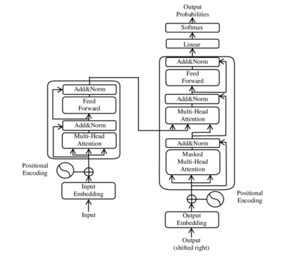
What We Will Be Doing
We will now go through all the different algorithms we will be looking at.
I will only give a quick summary. Read through the list of topics yourself.
Think about what you want to do for your project.

Slide 12
What We Will Be Doing (Read this list yourself)
Connectionist Models:
Unsupervised Learning:
Machine looks at data, and figures how on its own how to sort out the data into classes.
Good for “clustering” – Is this colour green, yellow, or greenish-yellow?
Algorithms:
k-Means Clustering
Kohonen Self Organizing Maps
Kohonen Self Organizing Map can be automatically trained to sort out colours to do colour classification.
No need for tagged data.

Slide 13
What We Will Be Doing (Read this list yourself)
Connectionist Models:
Supervised Learning:
These are great when you have enough “tagged” data to teach the computer.
Creation / acquisition of tagged data can be extremely expensive.
Techniques like Generative Adverserial Networks (GANs) can produce “fake” data that looks like real data, to augment real data sets.
Algorithms:
Perceptrons (Grandfather of deep learning)
Multilayer Perceptrons

Slide 14
What We Will Be Doing (Read this list yourself)
Deep Learning Models:
Recurrent Neural Networks
Great for learning patterns across time.
Long-Short Term Memories
Like RNNs but much more robust.
Transformers
Able to learn sequences in parallel.
Attention mechanisms
Convolutional Neural Networks
Most commonly used for images, but can be used elsewhere.
Key strength are its convolutional layers (detects key features) and pooling layers (summarizes features / removes noise).
Object Detection Networks
Detect, recognize and track objects in real-time.

Slide 15
What We Will Be Doing (Read this list yourself)
Generative Adversarial Networks
Forgers and police.
Forgers fake data, police try to catch them. Forgers improve their fakery to avoid getting caught.
Used to generate more data from existing samples of data.
Autoencoders
Train neural networks on this function f(x) = g(x).
Why?
Assume that g(x) is the output of some system, e.g. torque from an engine, and x is the input to the engine, e.g. throttle position.
When f(.) is fully trained, we will get |f(x) – g(x)| < ε where ε is some very small value (f(x) is never exactly g(x) because of noise in g(x), e.g. variations in oxygen levels in the air taken in by the engine, variations in temperature, etc.)
If at some point |f(x) – g(x)| > kε where k is some constant, we know that g(x) is producing abnormal values, possibly signalling a fault.
Autoencoders are thus very good at detecting faults in a system.

Slide 16
What We Will Be Doing (Read this list yourself)
Using Machine Learning is HARD!! We will look at:
Network sizing.
Kernel dimensions?
# of layers?
Pooling?
# of neurons in each layer?
Selection of training hyper-parameters:
Learning algorithms
Stochastic Gradient Descent?
Adam?
AdaMax?
???
Learning parameters
Learning Rate
Decay rate
Momentum

Slide 17
What We Will Be Doing (Read this list yourself)
Selecting Transfer Functions
Identity?
Sine, cosine?
Sigmoid?
ReLU, Leaky-ReLU?
Dealing with Overfitting
Dropouts?
L1 or L2 regularizers? Or none? Or both?
How much L1 and how much L2 to use?
Getting Data
Hunting for data.
Cleaning up the data.
Finding more data.
DATA DATA DATA!

Slide 18
What We Will Be Doing (Read this list yourself)
Statistical Models:
Convenient for many applications – fast, few hyperparameters, easy to train.
Linear Regression
Given a set of data, produce a function that can predict outcomes for unseen data.
E.g. Given historical room temperature by time and by season, predict the level of air-conditioning/heating needed for tomorrow.
Naïve Bayes Classifier
Model the statistical characteristics of the data.
Classify new data based on these characteristics.
Good for classifying data – E.g. given a series of temperature and light readings, what season are we in? (Autumn, spring?)

Slide 19
What We Will Be Doing (Read this list yourself)
Statistical Models:
Decision Trees
Look at the data and infer how decisions were made.
Support Vector Machines
Once viewed as the “saviour” of machine learning.
Look at the data and create “hyperplanes” to separate different classes of data.
Good for classifying data – More complex than Naïve Bayers but more robust.

Slide 20
SWS3009A Robotics and Deep Learning (Deep Learning)
Lectures will be a mix of theory and hands-on.
Language used: Python 3 (Python 2 is not supported).
Environment:
Lecture hands-on using Jupyter.
Labs: Any IDE you prefer. But real programmers use vim. ;)
There will be 5 lectures, and a lot of hands-on.
Covers key topics we don’t do in the lecture:
Creating and training statistical, neural network and deep learning models.
Generation of crypto keys.
Reverse proxies to control your robot from any part of the world.
This is a HEAVY but FUN course with a lot of work!

Slide 21
Installing the Course Environment (Intel Macbooks/Windows Machines Only)
You will need to install Python 3.x (preferably 3.7 or better). Python 2.x will NOT be supported.
Once installed:
Create a course directory. E.g. sws3009cool.
Change to that directory.
Create a virtual environment called venv:
python –m venv venv
Activate the environment:
source venv/bin/activate
Install all requirements by executing (this is one command):
pip3 install pandas pymongo tensorflow sklearn jupyter requests flask pillow matplotlib tqdm
Note: To exit the virtual environment, enter the following command:
deactivate

Slide 22
Special Note: Students with Apple M1 / M2 Macbooks
Please follow the instructions here:
https://developer.apple.com/metal/tensorflow-plugin/
Once Tensorflow has been installed, install the rest of your software (this is one command):
pip3 install pandas pymongo sklearn jupyter requests flask pillow matplotlib tqdm

Slide 23
Neural Networks Introduction
Now we will look at the basics of deep learning: Neural network learning laws.
Unsupervised learning.
Supervised learning using gradient descent.
Problems with neural networks and how to solve them.
We will also be looking at some hands-on for programming neural networks using Keras (built into TensorFlow).

Slide 24
introduction to learning laws

Slide 25
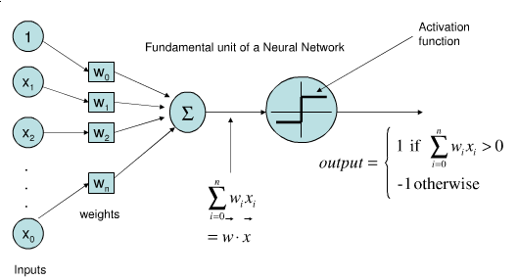
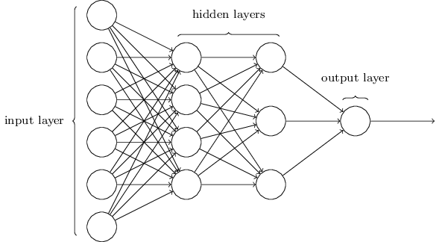
Revision: Neural Networks
Recall: Neural networks are made of neurons.
Like the biological neurons, the “neurons” here also sum inputs through weights.
The neuron “fires” (outputs a “1”) if the sum exceeds a threshold, through an “activation function”.
The summation is essentially a dot product w^{T}x, and the neuron can be specified by g(w^{T}x) where g(.) is the “activation function”.

Slide 26
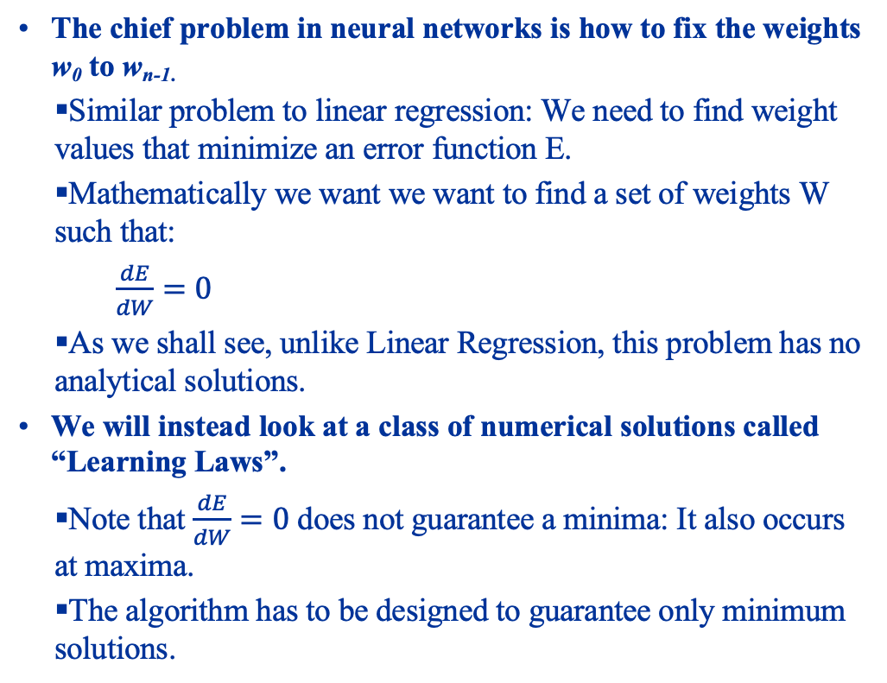
Revision: Neural Networks
The chief problem in neural networks is how to fix the weights w₀ to w_{n-1.}
Similar problem to linear regression: We need to find weight values that minimize an error function E.
Mathematically we want we want to find a set of weights W such that:
$\frac{dE}{dW}=0$
As we shall see, unlike Linear Regression, this problem has no analytical solutions.
We will instead look at a class of numerical solutions called “Learning Laws”.
Note that $\frac{dE}{dW}=0$ does not guarantee a minima: It also occurs at maxima.
The algorithm has to be designed to guarantee only minimum solutions.

Slide 27
Learning Laws
Two classes of learning laws:
Unsupervised learning:
Tons of data is thrown at the NN.
The NN does its own inference on the structure and relationships in the data.
Due to lack of time, we will not look at unsupervised learning. Materials are provided for your own self-learning.
Supervised learning:
We give the NN the data and the correct labels (or values we want to produce) from the data.
The NN then optimizes its weights to mimic the generator function for the data, based on what we tell it.

Slide 28
unsupervised learning

Slide 29
Unsupervised Learning
In unsupervised learning, the neural network is given data samples, but no descriptions of what the data samples mean.
The job of the neural network is then to automatically learn relationships and structure between the data samples.
There are several such networks:
Hebbian Learning: Neural networks that strengthen or weaken connections between neurons based on sample data.
Adverserial Learning: Two neural networks that compete with each other based on sample data.
Self Organizing Maps: A neural network that partitions the vector space based on sample data – “Clustering”.
In our lecture we will only look at self organizing maps.

Slide 30
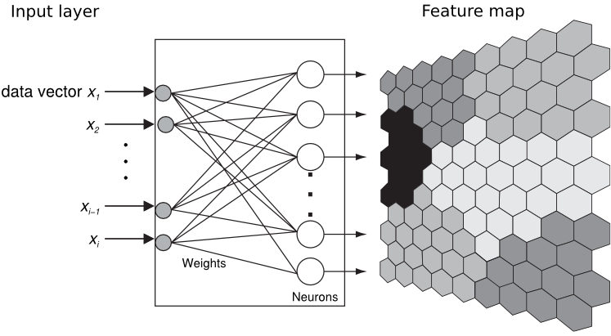
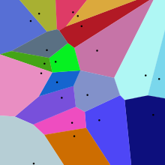
Unsupervised Learning Self Organizing Maps
The Self Organizing Map (SOM) is based on the following principles:
Given a sample vector v_{k},
The neuron (which we will call a “centroid”) that best matches v_{k} (bmu) AND
Its nearest neighbors
Are adjusted to look like v_{k}. This partitions the vector space into a “tesellated Voronoi surface.”
We begin first with a set of m centroids of dimension d:
We usually use values of between 0 and 1.
INITIAL VALUES DO AFFECT OUTCOME!
Can optimize performance by carefully choosing initial values.

Slide 31
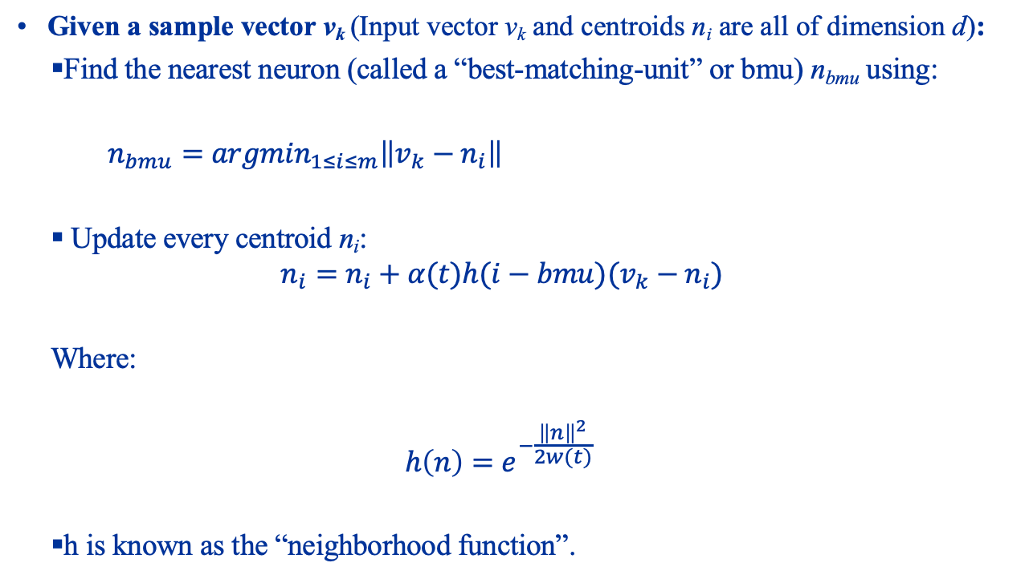
Unsupervised Learning The Kohonen SOM Algorithm
Given a sample vector v_{k} (Input vector v_{k} and centroids n_{i} are all of dimension d):
Find the nearest neuron (called a “best-matching-unit” or bmu) n_{bmu} using:
$n_{bmu}={argmin}_{1≤i≤m}\left\|v_{k}−n_{i}\right\|$
Update every centroid n_{i}:
$$n_{i}=n_{i}+α(t)h(i−bmu)(v_{k}−n_{i})$$
Where:
$$h\left(n\right)=e^{−\frac{{\left\|n\right\|}^{2}}{2w(t)}}$$
h is known as the “neighborhood function”.

Slide 32
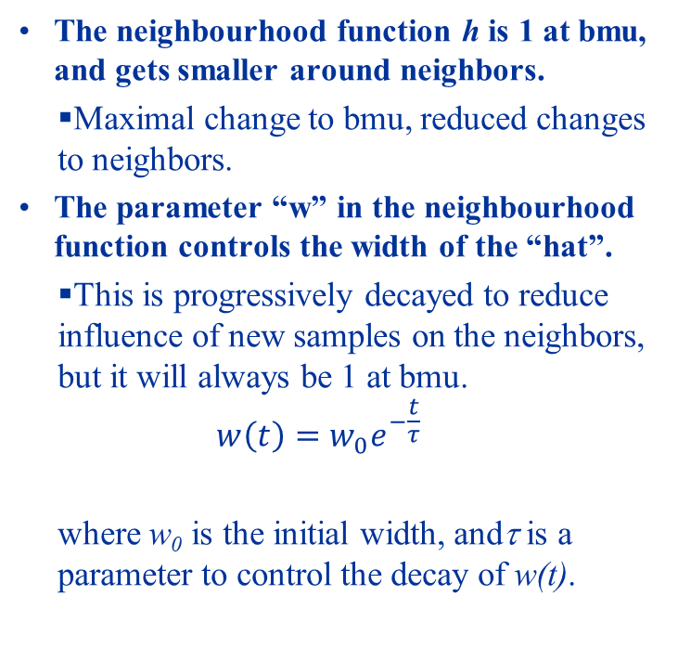
Unsupervised Learning The Kohonen SOM Algorithm
The neighbourhood function h is 1 at bmu, and gets smaller around neighbors.
Maximal change to bmu, reduced changes to neighbors.
The parameter “w” in the neighbourhood function controls the width of the “hat”.
This is progressively decayed to reduce influence of new samples on the neighbors, but it will always be 1 at bmu.
$$w\left(t\right)=w_{0}e^{−\frac{t}{τ}}$$
where w₀ is the initial width, andτ is a parameter to control the decay of w(t).

Slide 33
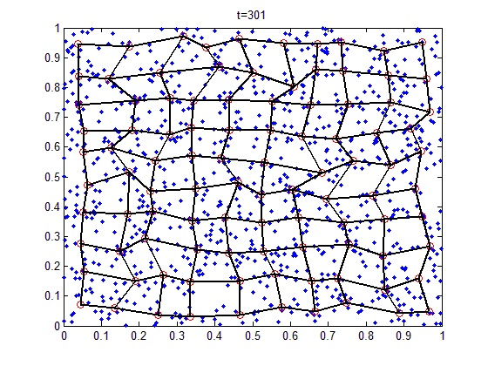
Unsupervised Learning The Kohonen SOM Algorithm
The learning rate α(t) is similarly decayed.
The end-result:
Neurons (sometimes called “centroids”) and their nearest neighbors are adapted to look like the sample data that are closest to them.
Likewise new sample data coming in will automatically be “classified” as the centroid they closest to:
This means that they will be “classified” together with other data that “looks” like them.
Thus the Kohonen SOM automatically infers structure from the sample data presented to it.

Slide 34
Kohonen SOM Example – Color Classification
Color is described by a triplet (r,g,b), with r, g and b ranging from 0 to 255:
(0,0,0) is black, (255, 255, 255) is white.
(255,0,0) is pure red, (0, 255, 0) is pure green, (0, 0, 255) is pure blue.
Total number of possible colors = 256 x 256 x 256 = 16,777,216 colors.
Usual to scale all values to between 0 and 1 to minimize chance of overflow.
Full video: https://www.youtube.com/watch?v=71wmOT4lHWc

Slide 35
Supervised learning

Slide 36
Supervised Learning
Unlike unsupervised learning algorithms like Kohonen SOMs, in supervised learning we must tell the network what it is looking at.
Generally data is presented in the form of (x_{i}, y_{i}), where x_{i} is the sample input, and y_{i} is some kind of target or class that the neural network needs to learn.
We will look at two related supervised learning algorithms:
Linear Perceptrons:
Simple, good for classifying linearly separable data.
Multi-layer Perceptrons:
More complex, good for classifying non-linearly separable data.

Slide 37
Supervised learning : Perceptrons

Slide 38
Supervised Learning Perceptrons
A single Perceptron (Mculloch – Pitts) neuron consists of:
A set of inputs x.
A set of “weights” w.
A unit that does a dot product w^{T}x.
An activation function that does outputs 1 when w^{T}x+b >0, and -1 otherwise. (other functions are possible, e.g. the identity function id(x)=x)
The bias b is normally modelled as a unit input, with the weight w₀ becoming the bias.

Slide 39
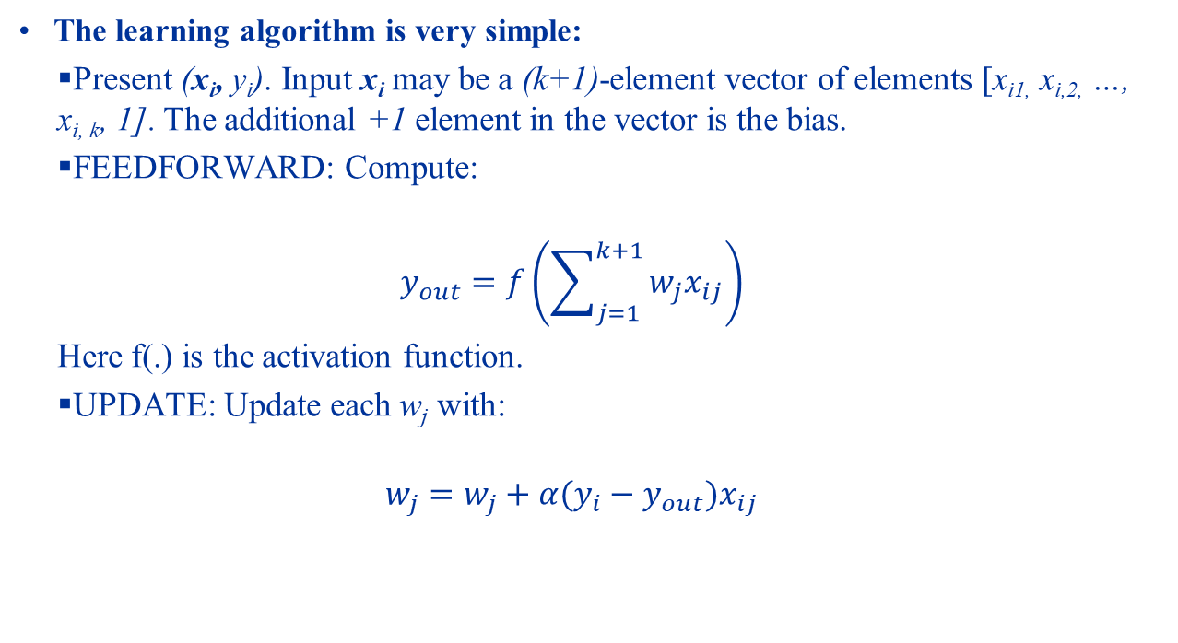
Supervised Learning Perceptrons
The learning algorithm is very simple:
Present (x_{i}, y_{i}). Input x_{i} may be a (k+1)-element vector of elements [x_{i1,} x_{i,2,} …, x_{i, k}, 1]. The additional +1 element in the vector is the bias.
FEEDFORWARD: Compute:
$$y_{out}=f\left(\sum_{j=1}^{k+1}{w_{j}x_{ij}}\right)$$
Here f(.) is the activation function.
UPDATE: Update each w_{j} with:
$$w_{j}=w_{j}+α(y_{i}−y_{out})x_{ij}$$

Slide 40
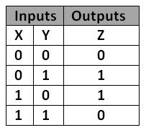
Supervised Learning Perceptrons (perceptron.xlsx)
Function learning (Activation Function: id(x)=x)
y(x) = 2x
y(x)=2x+5
y(x) = 2x+5 + noise
y(x) = 2x+5 + large noise
Classification:
Given the length and weight of a vehicle we want to classify either as a lorry (-1) or a van (1)
Activation function f(x)=1 if x>0, -1 otherwise.
XOR Problem:
Learn the XOR table.
Activation: f(x)=1 if x>0, 0 otherwise.

Slide 41
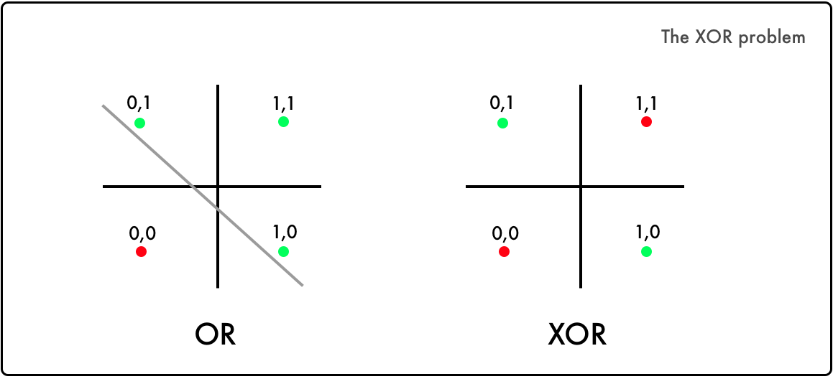
Supervised Learning Perceptrons
From our example we see that Perceptrons cannot learn the XOR problem.
This is because it is not possible to draw a straight line to separate the samples into two classes.
Neural network research was killed for several years because no solution could be found for this problem.

Slide 42
Supervised learning: Multi-layer perceptrons

Slide 43
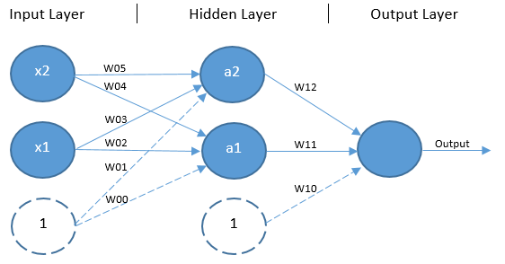
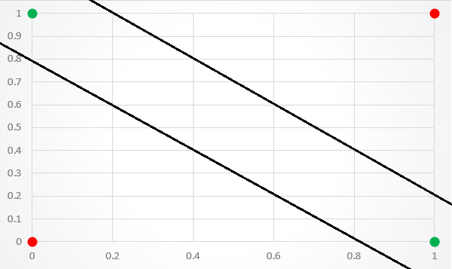
Supervised Learning Multi-Layer Perceptrons
Our key issue in the XOR problem with a single Perceptron is that we cannot separate the points in the XOR problem with a SINGLE linear plane.
However if we add a second Perceptron layer, we introduce a second plane that can neatly separate the points:

Slide 44
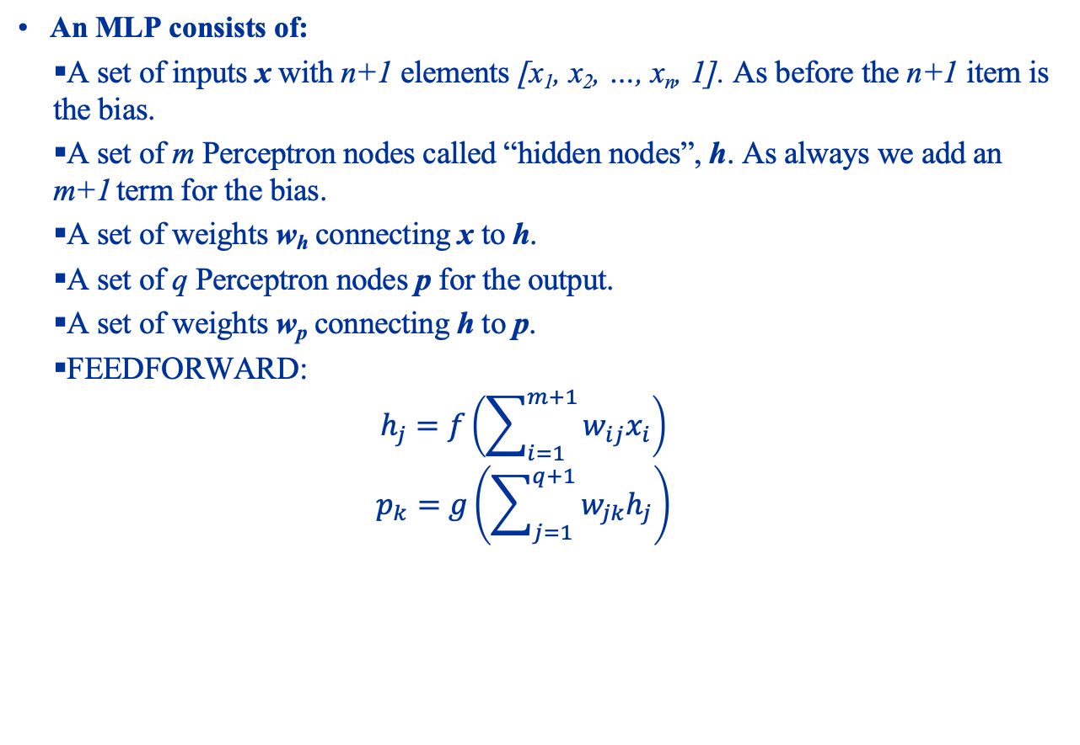
Supervised Learning Multi-Layer Perceptrons
An MLP consists of:
A set of inputs x with n+1 elements [x₁, x₂, …, x_{n}, 1]. As before the n+1 item is the bias.
A set of m Perceptron nodes called “hidden nodes”, h. As always we add an m+1 term for the bias.
A set of weights w_{h} connecting x to h.
A set of q Perceptron nodes p for the output.
A set of weights w_{p} connecting h to p.
FEEDFORWARD:
$$h_{j}=f\left(\sum_{i=1}^{m+1}{w_{ij}x_{i}}\right)$$
$$p_{k}=g\left(\sum_{j=1}^{q+1}{w_{jk}h_{j}}\right)$$

Slide 45
Supervised Learning Multi-Layer Perceptrons
The update step is considerably more complicated than single layer Perceptrons:
In SLP there is only one “output” layer. It is relatively easy to compute the error, which is simply y_{t} – y_{out}.
In MLP, things get more complicated in the hidden layer. How do we assign errors to this layer?

Slide 46

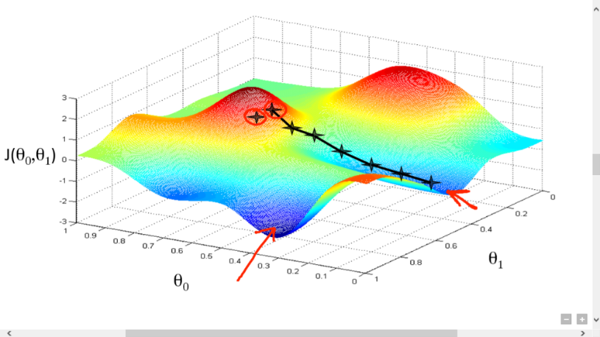
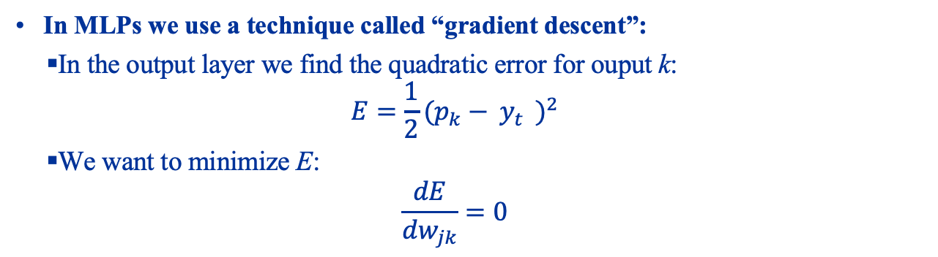
Supervised Learning Multi-Layer Perceptrons
In MLPs we use a technique called “gradient descent”:
In the output layer we find the quadratic error for ouput k:
$$E=\frac{1}{2}{(p_{k}− y_{t}^{})}^{2}$$
We want to minimize E:
$$\frac{dE}{dw_{jk}}=0$$

Slide 47
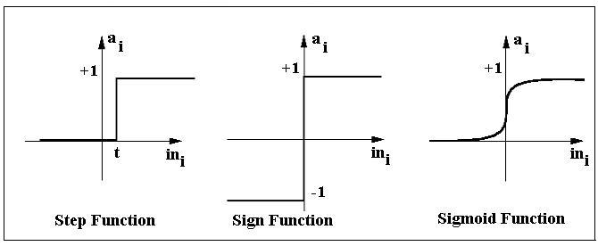
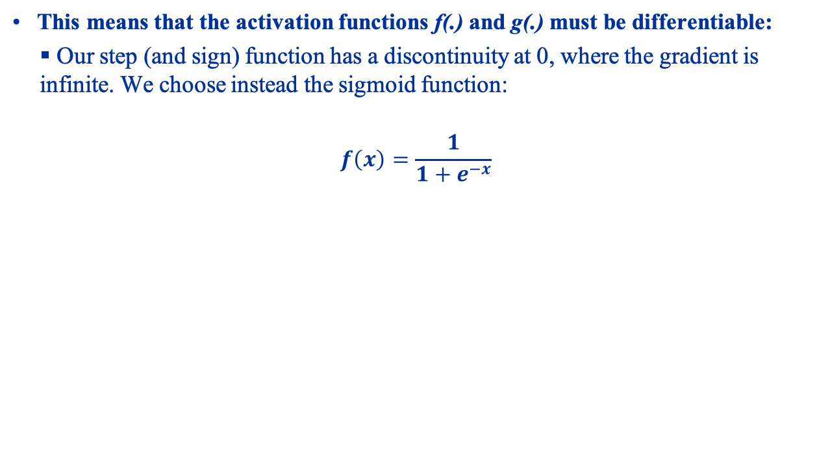
Supervised Learning Multi-Layer Perceptrons
This means that the activation functions f(.) and g(.) must be differentiable:
Our step (and sign) function has a discontinuity at 0, where the gradient is infinite. We choose instead the sigmoid function:
$$f\left(x\right)=\frac{1}{1+e^{−x}}$$

Slide 48
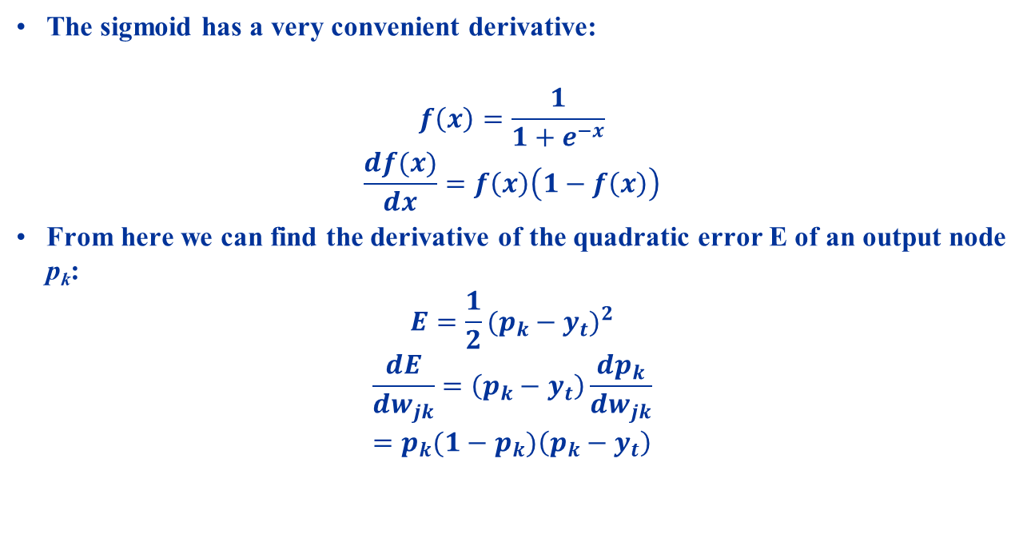
Supervised Learning Multi-Layer Perceptrons
The sigmoid has a very convenient derivative:
$$f\left(x\right)=\frac{1}{1+e^{−x}}$$
$$\frac{df(x)}{dx}=f\left(x\right)\left(1−f\left(x\right)\right)$$
From here we can find the derivative of the quadratic error E of an output node p_{k}:
$$E=\frac{1}{2}{(p_{k}−y_{t})}^{2}$$
$$\frac{dE}{dw_{jk}}=\left(p_{k}−y_{t}\right)\frac{dp_{k}}{dw_{jk}}$$
$$=p_{k}(1−p_{k})\left(p_{k}−y_{t}\right)$$

Slide 49
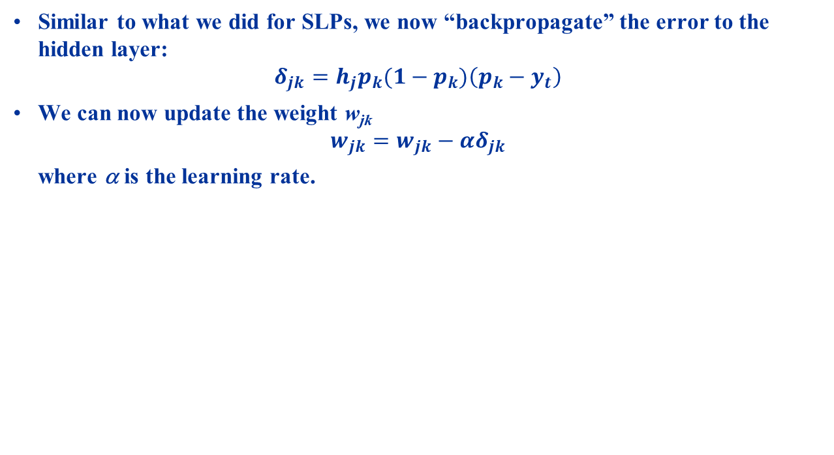
Supervised Learning Multi-Layer Perceptrons
Similar to what we did for SLPs, we now “backpropagate” the error to the hidden layer:
$$δ_{jk}=h_{j}p_{k}(1−p_{k})\left(p_{k}−y_{t}\right)$$
We can now update the weight w_{jk}
$$w_{jk}=w_{jk}−αδ_{jk}$$
where α is the learning rate.

Slide 50
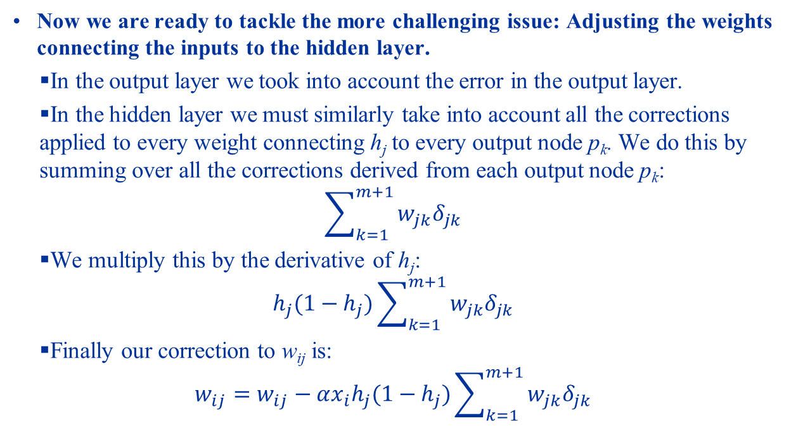
Supervised Learning Multi-Layer Perceptrons
Now we are ready to tackle the more challenging issue: Adjusting the weights connecting the inputs to the hidden layer.
In the output layer we took into account the error in the output layer.
In the hidden layer we must similarly take into account all the corrections applied to every weight connecting h_{j} to every output node p_{k}. We do this by summing over all the corrections derived from each output node p_{k}:
$$\sum_{k=1}^{m+1}{w_{jk}δ_{jk}}$$
We multiply this by the derivative of h_{j}:
$$h_{j}(1−h_{j})\sum_{k=1}^{m+1}{w_{jk}δ_{jk}}$$
Finally our correction to w_{ij} is:
$$w_{ij}=w_{ij}−αx_{i}h_{j}(1−h_{j})\sum_{k=1}^{m+1}{w_{jk}δ_{jk}}$$

Slide 51
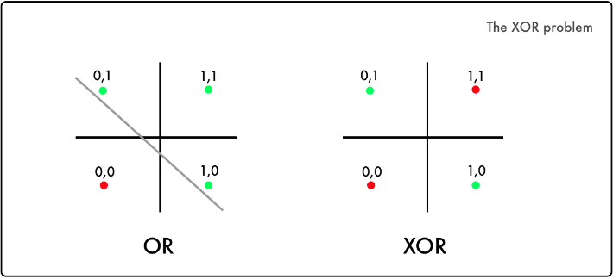
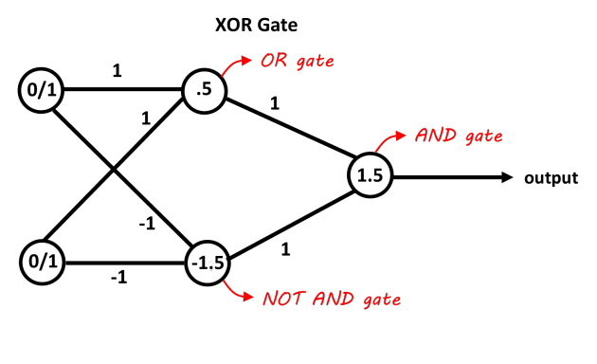
Supervised Learning Multi-Layer Perceptrons – XOR Problem
Recall that Perceptrons cannot solve the XOR problem:
Adding a hidden layer solves this problem:

Slide 52
Supervised learning: Introducing non-linearity

Slide 53
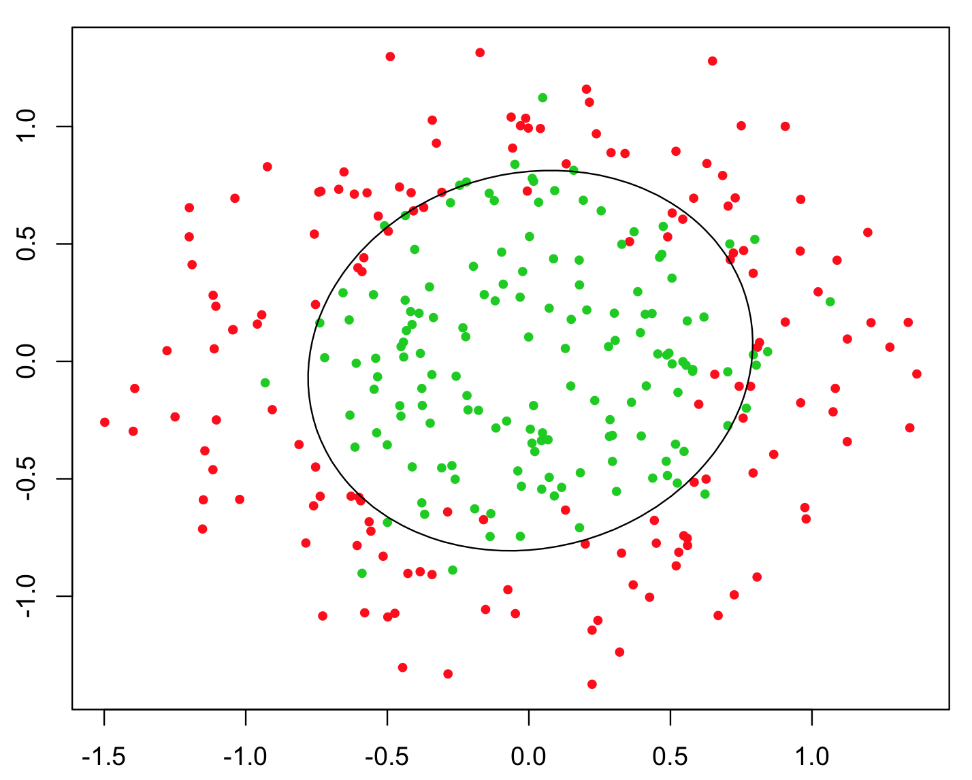
Supervised Learning Non-Linearity
The addition of a hidden layer only partially solves the problem of classifying data points:
What if the data points occur in a circle? No straight hyperplane can solve this.
Solution: Use non-linear decision boundaries.
Popular ones: Sigmoid for (0, 1) outputs, tanh for [-1, 1] outputs, and ReLu.

Slide 54
Neural Network Hyperparameters
The weights that are being adjusted by our optimization algorithms are called “parameters”, and neural networks are known as “parameterized models”.
There is another dimension of neural networks that must be “optimized” as well to get good results, called ”hyperparameters”. This is related to the design of the neural network. Important hyperparameters include:
Architecture (Dense networks, Long-Short-Term Memories, Convolutional Neural Networks, Autoencoders, Generative-Adversarial Networks, etc)
# of input nodes (usually constraints by the problem itself)
Input and output encoding.
# of hidden layers.
Size of each hidden layer.
Loss functions
Transfer functions.
Optimization functions and their parameters (learning rate, momentum, etc.)
Dropouts and Regularizers.

Slide 55
Neural Network Hyperparameters
Some of the parameters are constrained by the problem itself (e.g. input and output size), others are found by trial-and-error (yes really).
We will look at a subset of hyperparameters that are slightly more “scientific”
Transfer Functions
We’ve already seen the sigmoid and step functions.
Dropouts and Regularizers
These control the issue of “overfitting”

Slide 56
Recall: Neural Networks and How They Work.
Generally neural network applications can be split into two classes:
Classification:
Given a set of inputs {x₀, x₁, …., x_{n-1}}, assign labels y_{j} to each input x_{i} from the set of classes {y₀, y₁, …, y_{m=1}}, to mean that x_{i} is a member of class y_{j}.
E.g. we may classify a library of books into the genres of novels, cookbooks, self-improvement books, etc.
Regression:
Give a series of data of data {x₀, x₁, …., x_{n-1}}, can we predict x_{n}?
In either case we are attempting to learn a function f(x):
Classification: What f(.) gives f(x_{i}) = y_{i}?
Regression: What g(.) gives g(x_{n-1}) = x_{n}?

Slide 57
Recall: Neural Networks and How They Work.
The figure below shows an example neuron:
The sum of each neuron is passed through an activation function to transform it in some way.
E.g. scale it from -1 to 1 or 0 to 1.
Destroy the linearity of the output.
Shape it into a statistical distribution.
The weights need to be adjusted to create f(x):
We must know the error ||y_{i} – f(x_{i})||. This is called the “loss function”
We must have an algorithm to adjust the weights accordingly. This is done by “optimizers”.
Let’s now take a closer look at each of these important parts.

Slide 58
Activation Functions
An activation function (often also called “transfer function”) transforms the dot product of the weights and inputs.
Needed because this dot product is usually unbounded.
Also because the dot-product is a linear operation. Linearity prevents NNs from solving certain classes of problems. Explained in next section.
One obvious limitation: A linear function cannot regress over non-linear functions.
The table on the next slide shows the various common activation functions.

Slide 59
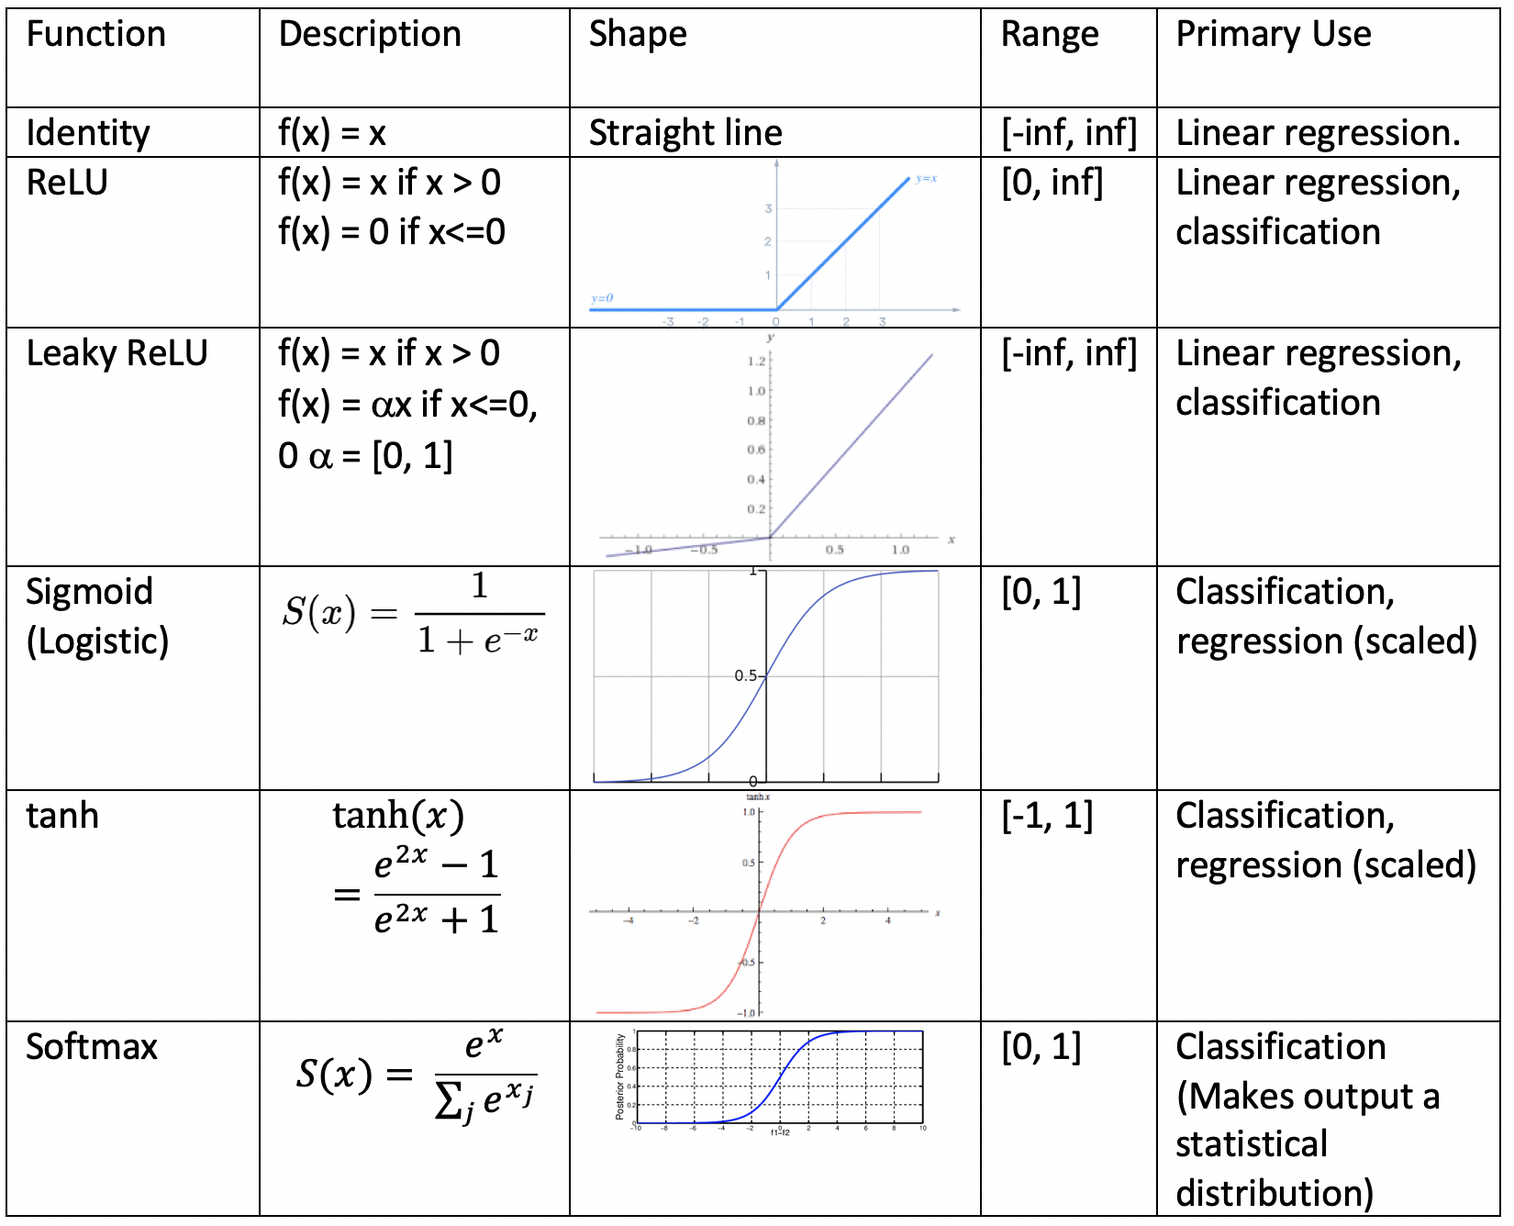

Slide 60
Loss Functions
A loss function measures the error between the function f(x_{i}) learnt by the NN and the actual target value y_{i}.
In regression y_{i} might just be x_{i+1}.
The table on the next page shows the common loss functions:

Slide 61
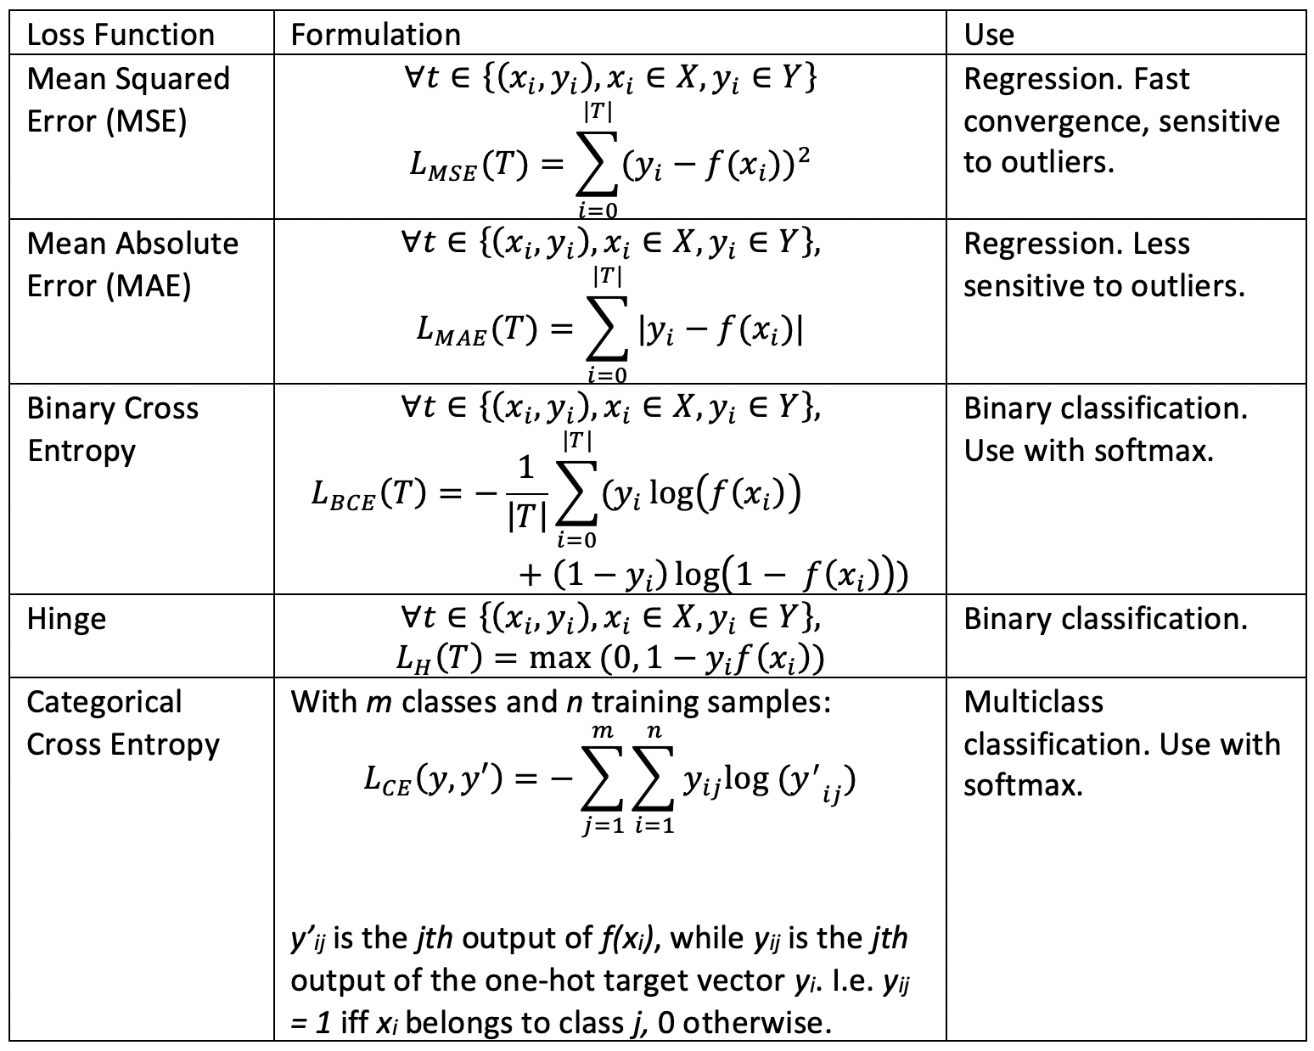

Slide 62
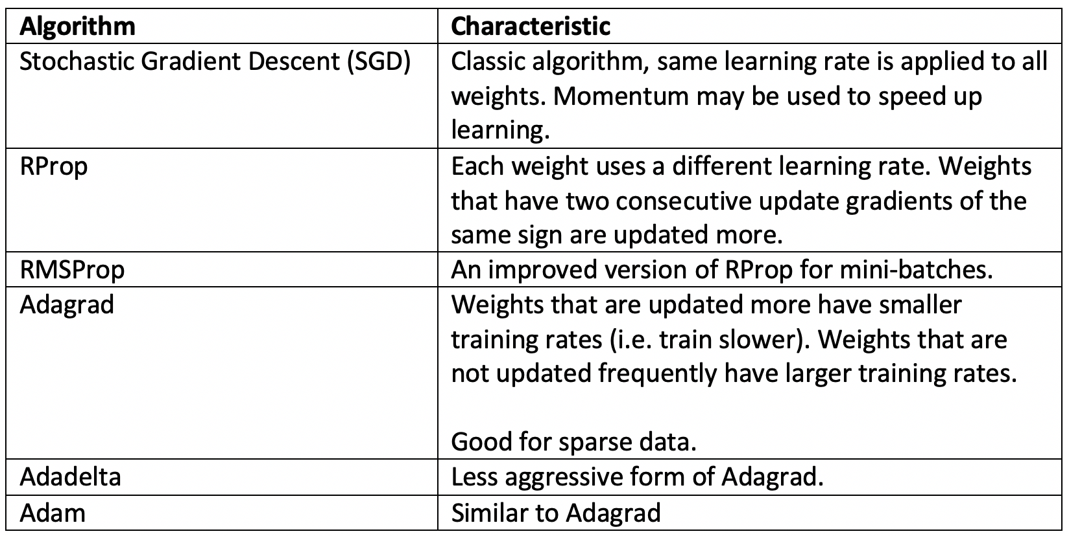
Optimizers
In NNs, optimizers are algorithms that derive the best set of parameter values that minimize the loss function (see later).
Table shows a small set of optimizers and their characteristics – No straightforward way to choose!

Slide 63
overfitting

Slide 64
Overfitting
All data can be thought of as consisting of two things:
Some sort of generator process f(x). The input x could simply be time, or an actual input.
Noise
When we build a model, we want it to learn only the generator process f(x).
The noise is random and unique to the training data. If we learn the noise then our model cannot generalize well – “overfitting”.
Two choices to avoid learning the noise:
Have a simple model (i.e. fewer parameters)
Have more training data so that the network can ”average out” the noise.
Catch:
A simple model may not learn f(x) well – underfitting.
The amount of training data needed grows exponentially with the model complexity – “curse of dimensionality”

Slide 65
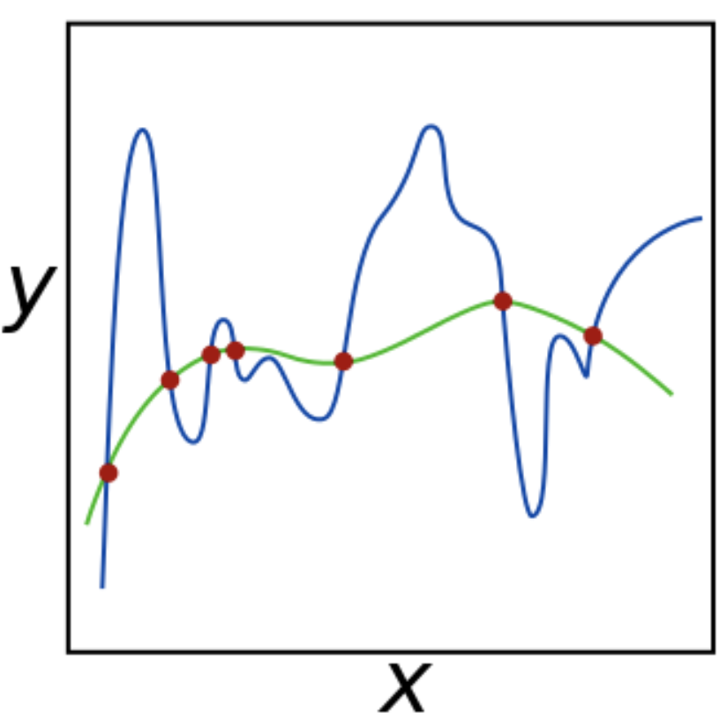
Overfitting
When we have too many parameters, we tend to learn the blue noisy line instead of the better green line:
Marked by:
Extremely low training loss.
Increasing validation loss.
Hence why we must check both!

Slide 66
Dealing with Overfitting Noise Layers
Dropout Layers:
A fixed percentage of neurons in the layer are dropped from training for one more epochs.
They are then put back in, and another percentage of neurons are dropped.
Reduces # of training paramters:

Slide 67
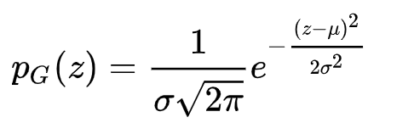
Dealing with Overfitting Noise Layers
Noise layers add random noise to the outputs of the previous layer.
E.g. add Gaussian noise to change the data to look like “new data” – augmentation.
In Gaussian noise the values of the noise are distributed according to the Gaussian probability distribution function:
In images this simulates sensor noise, e.g. due to low-light.
More details at https://keras.io/layers/noise/

Slide 68
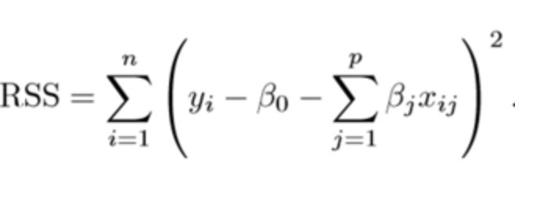
Dealing with Overfitting Regularizers
Regularizers:
A “regularizer” is a penalty that is applied to the loss function of a layer.
E.g. In regression our loss function may look like this (squared error loss):
Our optimization algorithm will find values of the parameters (β) to minimize this loss function.
If there are too many parameters (β) the model starts of learn the unique noise of the training data – overfitting or “memorizing”. Poor generalization.
We force a reduction – simplification - in parameters:
This is equivalent to forcing some of the parameters to 0.

Slide 69
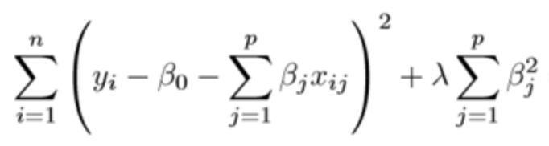
Dealing with Overfitting Regularizers
We can do this by adding the absolute values of the parameters (L1 regularization) or squares of the parameters (L2 regularization) to the loss function:
Now our optimizer will restrict the parameters themselves:
Some will be forced to zero while others are not allowed to grow too big.
Otherwise the loss function will become too much.
The hyperparameter λ controls how much “flexibility” we give to the parameters. Higher λ means more strict control.
L1: Eliminates less important parameters and simplifies the output.
L2: More effective in severe overfitting since it squares the parameters.
If λ is too high the model will underfit.

Slide 70
Dealing with Overfitting Regularizers
Regularizers are added to individual layers:
kernel_regularizer: Controls the main weights (lines connecting the green nodes)
bias_regularizer: Controls the bias weights (lines connecting the orange nodes)
activity_regularizer: Controls based on layer output (o1 and o2)

Slide 71
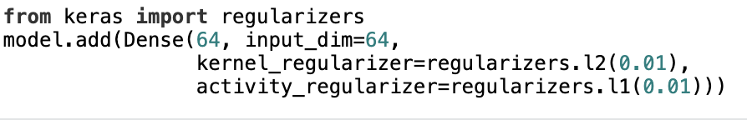
Dealing with Overfitting Regularizers
Example (From Keras, which we will see in the hands-on)
The λ is specified in the brackets of regularizers.l1(..) or regularizers.l2(..).
Here it is set to 0.01.

Slide 72
Neural Network Hands-On
Load up NN.ipynb in Jupyter Notebook

Slide 73
Keras Resources:
Sequential Model: https://keras.io/models/sequential/
Functional API: https://keras.io/models/model/
Core Layers (including Dropout): https://keras.io/layers/core/
Regularization Layers: https://keras.io/api/layers/regularization_layers/
Convolution Layers: https://keras.io/layers/convolutional/
Pooling Layers: https://keras.io/layers/pooling/
Recurrent Layers (including LSTM): https://keras.io/layers/recurrent/
Regularizers: https://keras.io/regularizers/
Activations: https://keras.io/activations/
Losses: https://keras.io/losses/
Optimizers :https://keras.io/optimizers/

Slide 74
Summary
In this lecture we saw:
Our various options for setting up convolutional neural networks.
The various activation and loss functions and optimization algorithms.
How to deal with overfitting.
NN algorithms.
In the next lecture we will look at statistical models:
These are often much simpler, have much better theoretical foundations, and require less training data.

Slide 75
Trial Lecture Hands On
You will be randomly assigned into rooms.
Spend 5-10 minutes getting to know each other.
Download ”SWS3009 Trial – Neural Networks.ipynb” from Canvas.
Load this into Jupyter.
Work together to solve the questions.
Submit by Thursday 30 May 2024 11.59 pm.
Quiz: Complete by Wednesday 29 May 2024

